Slide 1
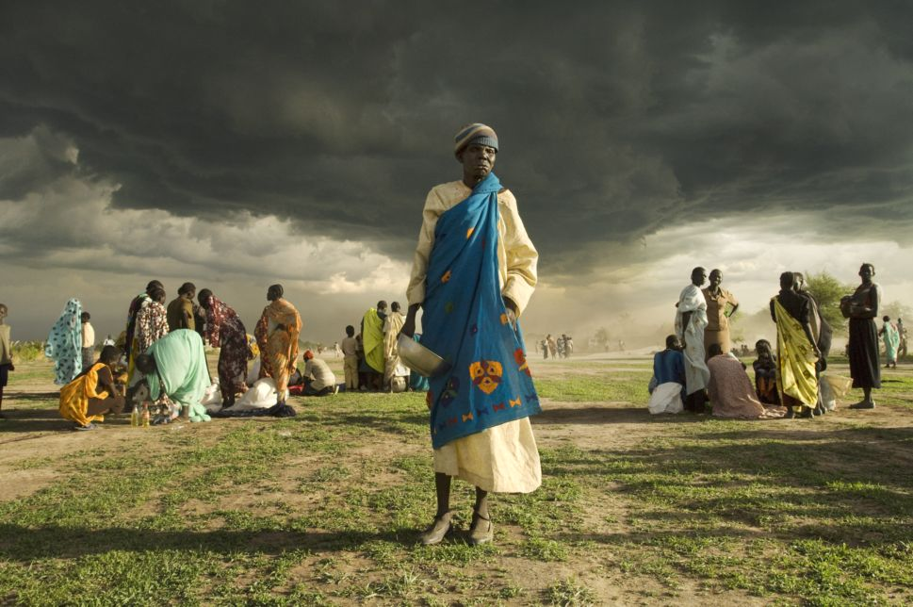
Tami Caraballo & Ryan Hauck Glacier Peak High School
Climate Change and Human Rights
In Collaboration with Western Washington University, Facing the Future, and World Affairs Council, Seattle
Nov. 3, 2016
Poulsbo, WA

Slide 2
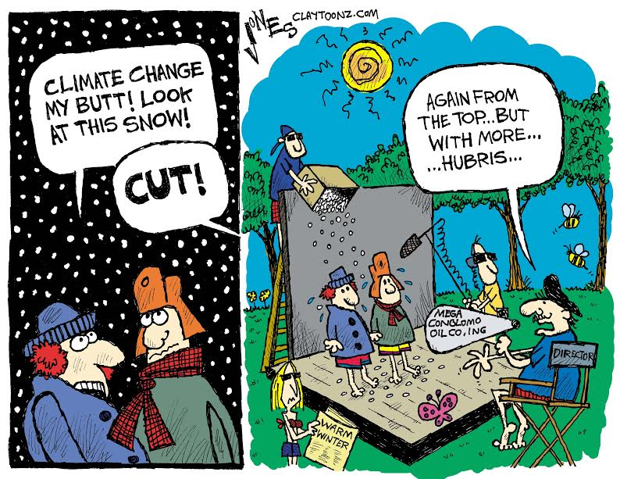

Slide 3
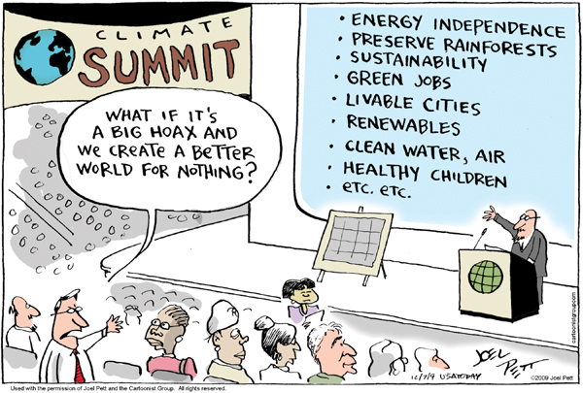

Slide 4
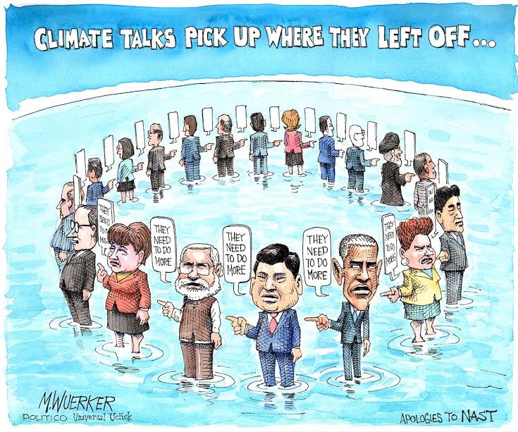

Slide 5
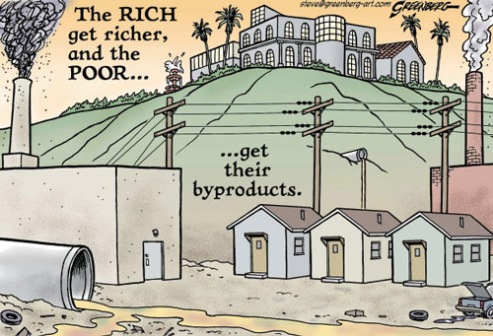

Slide 6
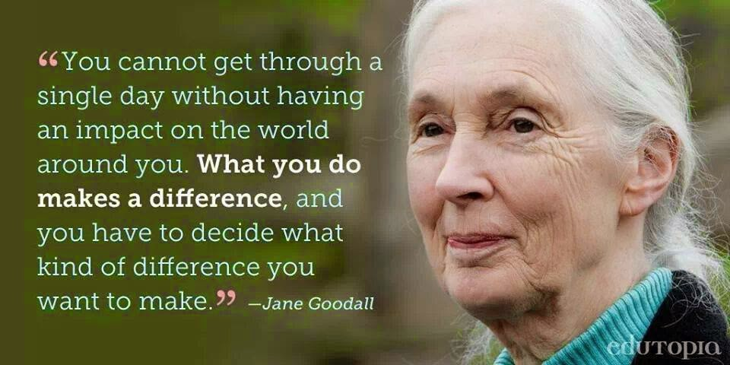

Slide 7
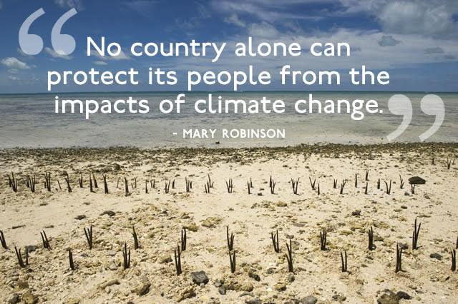

Slide 8
Essential Questions
What is climate justice?
How are human rights (which rights are most affected) and climate change connected? How would you explain this concept in your own words?
What can individuals and societies do to diminish the impact of climate change on humans and the environment?
What role and/or responsibility do nations and organizations (local, national, international) have in addressing the consequences of climate change on society?

Slide 9
Great Video Links to Introduce the Topic to Students
https://www.youtube.com/watch?v=u05C7bIkYm8 (Girl Effect)
https://www.youtube.com/watch?v=k4FAiI2mdaI (Millennium Development Goals)
https://www.youtube.com/watch?v=kR-YRC5D-QY (Millennium Development Goals)
https://www.youtube.com/watch?v=5PQKYt6H4Fw&feature=youtu.be (Climate Justice Intro Video)

Slide 10
Millennium Development Goals
What are the Millennium Development Goals? What topics and/or issues are represented in these goals?
How do the Millennium Development Goals relate to Climate Change and Human Rights/Climate Justice?
Millennium Development Goals Activity: Beyond Boundaries

Slide 11
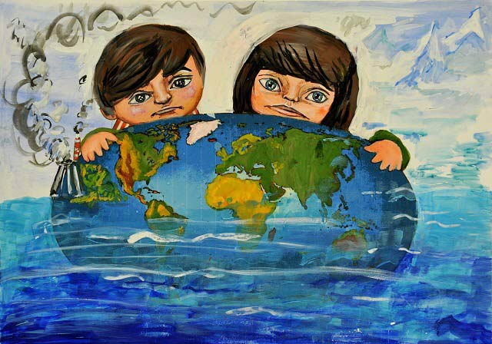
Integrating 21st Century Skills & Interdisciplinary Activities into Climate Justice

Slide 12
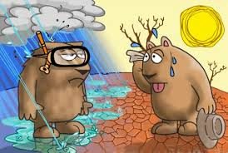

Slide 13
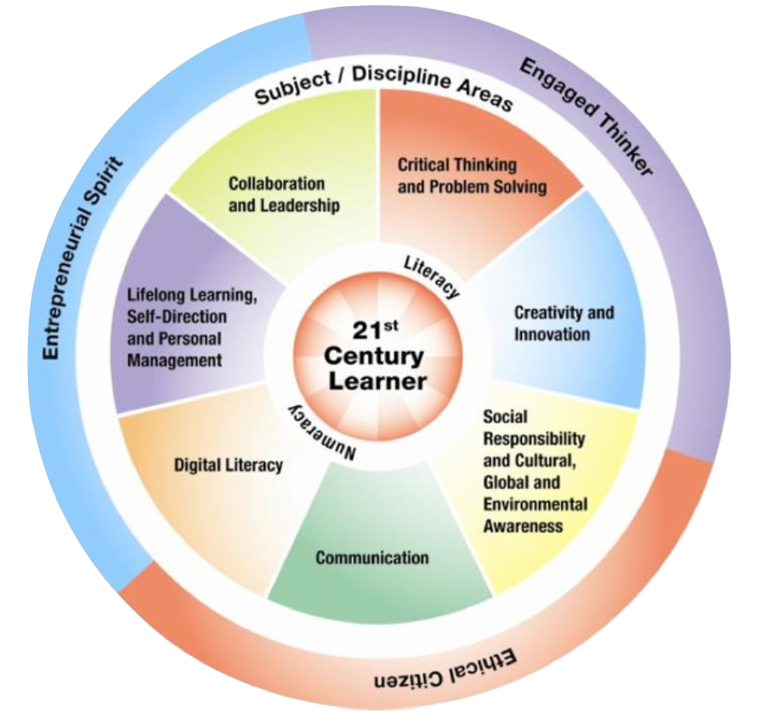

Slide 14
Close Reading Activity
http://www.tnp.no/norway/global/3965-climate-change-as-a-human-rights-and-justice-issue-op-ed
How can we get students to read analytically?
How can we help students to contextualize as well as become actively engaged readers?
Additional activity – “Cubing”

Slide 15
Key Messages on Human Rights & Climate Change (UN Human Rights Commission)
What are the “key messages” we want students to explore, analyze, and understand with regard to human rights and climate change?
http://www.ohchr.org/Documents/Issues/ClimateChange/COP21.pdf
Are there opportunities for students to “take action” locally, nationally, and/or globally on these key messages?

Slide 16
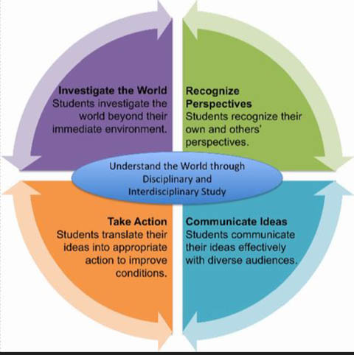
Global Competency Through the Lens of Climate Change and Human Rights

Slide 17
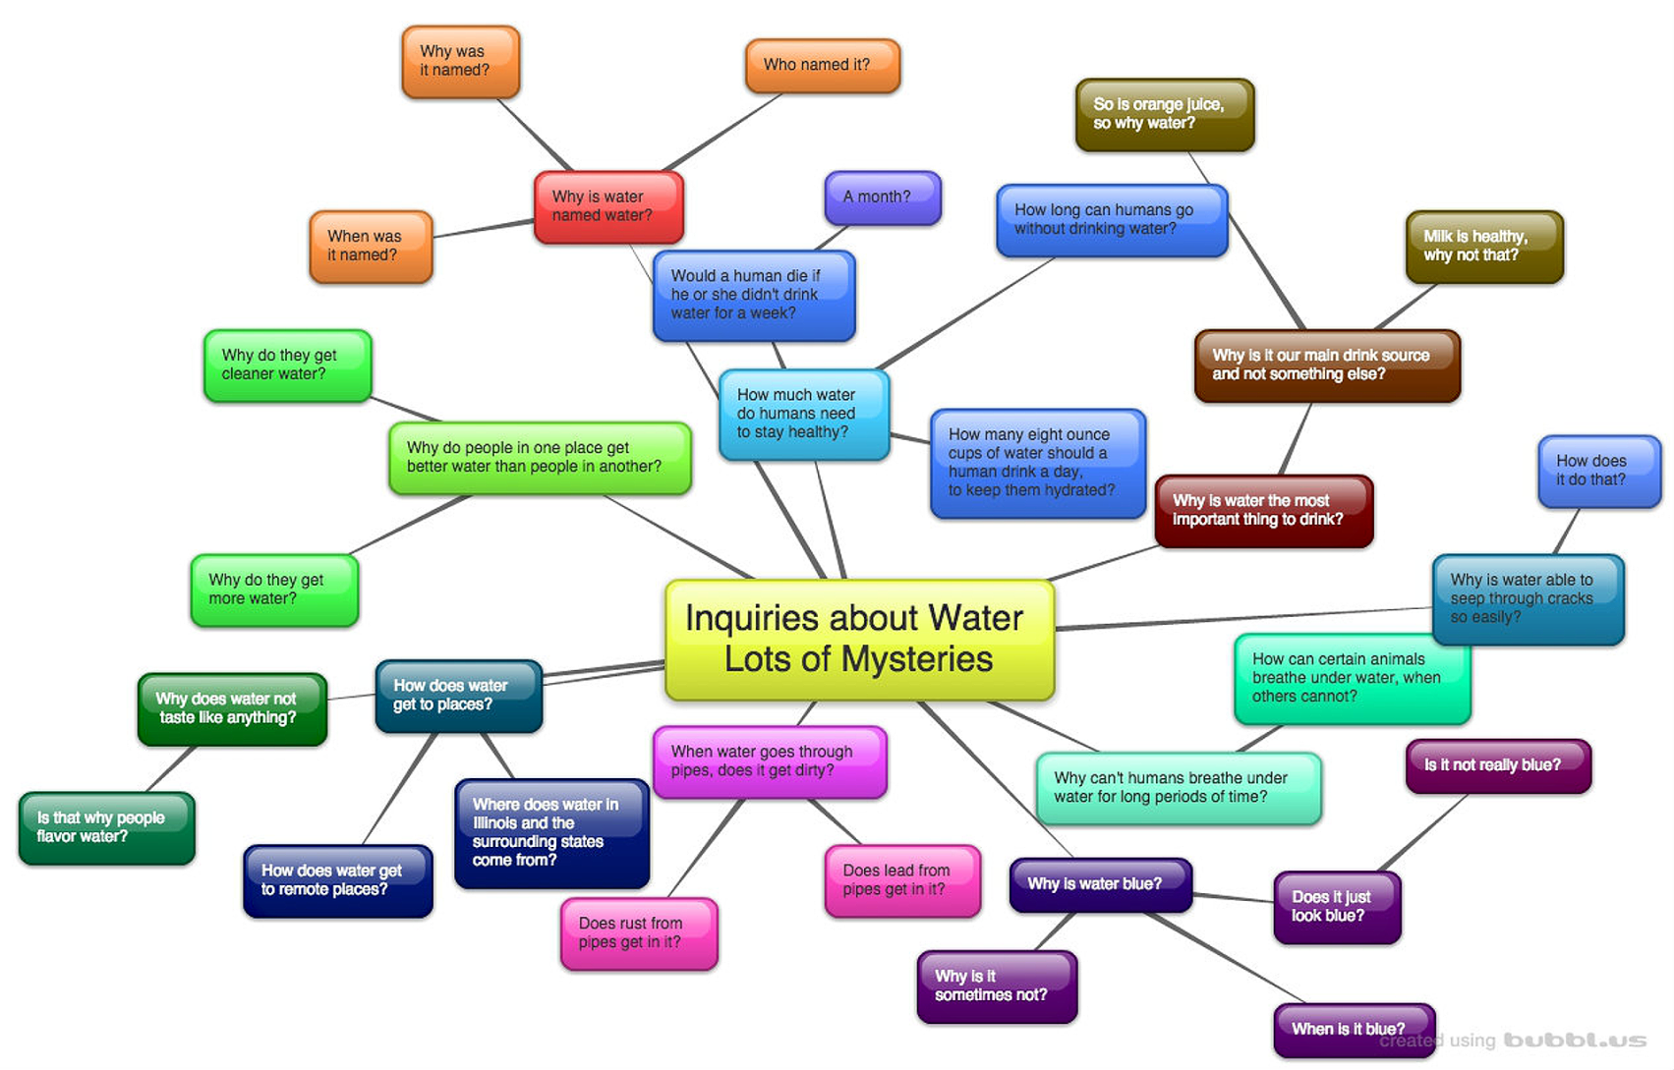
Mind Map for Climate Justice and/or Climate Change & Human Rights???

Slide 18
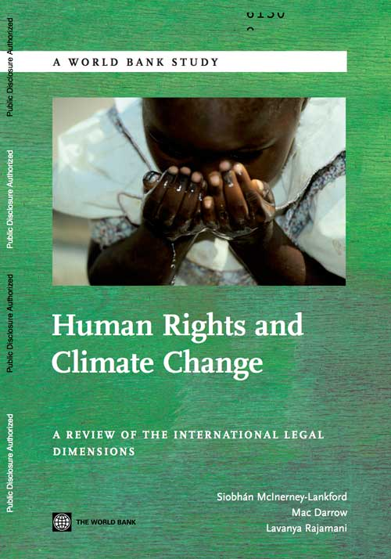
Closing Activity
Unfair Race Activity

Slide 19
Additional Resources…Be Sure to Check out the Resource Packet for Lesson Plans, Links, etc.
http://www.ohchr.org/EN/Issues/HRAndClimateChange/Pages/HRClimateChangeIndex.aspx
http://www.un.org/sustainabledevelopment/blog/2016/08/un-experts-make-human-rights-priority-in-conservation/

