Slide 1
Sustainable Development Goals: Girls at the Center of Development
Wendy Ewbank and Ryan Hauck
January 26, 2017

Slide 2
Clips You Can Use With Students
https://www.youtube.com/watch?v=wWzmbdfykdU
https://www.youtube.com/watch?v=nbhjXK2mMe8

Slide 3
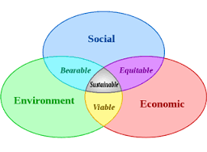
3 Dimensions of Sustainable Development
“We can be the first generation to end extreme poverty, the most determined generation in history to end injustice and inequality, and the last generation to be threatened by climate change.”

Slide 4
Girls at the Center of Development
“There are more than 500 million adolescent girls living in the developing world today. Every one of them can potentially help break the cycle of intergenerational poverty, with ripple effects multiplying across her society.” – Anthony Lake, Executive Director of the United Nations Children’s Fund (UNICEF)

Slide 5
Gender Equality
“Girls are one of the most powerful forces for change in the world: When their rights are recognized, their needs are met, and their voices are heard, they drive positive change in their families, their communities, and the world.” – Kathy Calvin, United Nations Foundation President & CEO

Slide 6
Women’s Empowerment through the Lens of Global Competency

Slide 7
How Can We Incorporate 21st Century Skills into our Teaching of Gender Equality and the SDGs?

Slide 8
Empowerment Through Education for All
“We cannot all succeed when half of us are held back. We call upon our sisters around the world to be brave – to embrace the strength within themselves and realize their full potential.” – Malala Yousafzai, Nobel Peace Prize winner

Slide 9
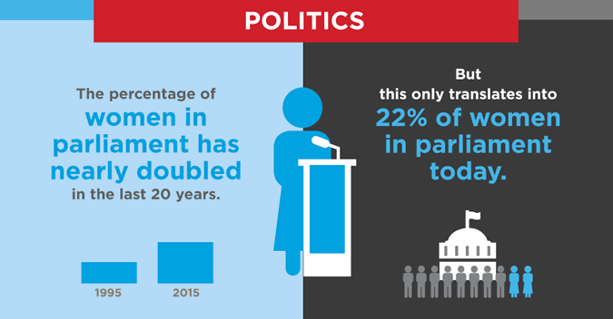
Women in Government

Slide 10
Wendy Ewbank – Seattle Girls’ School
Wendy will reflect on
opportunities for
girls’ empowerment
and her experiences
at the Seattle Girls’
School

Slide 11
Empowerment through the Lens of a Student - Go Ziah!

Slide 12
Connections in Senegal – 10,000 Girls Project
Dr. Viola Vaughn (CNN Hero of the Year)
WHEPSA’s (Women’s Health Education and Prevention Strategies Alliance)
An innovative approach that integrates education and employment for girls in a self-sustaining program in rural, southeast Senegal

Slide 13
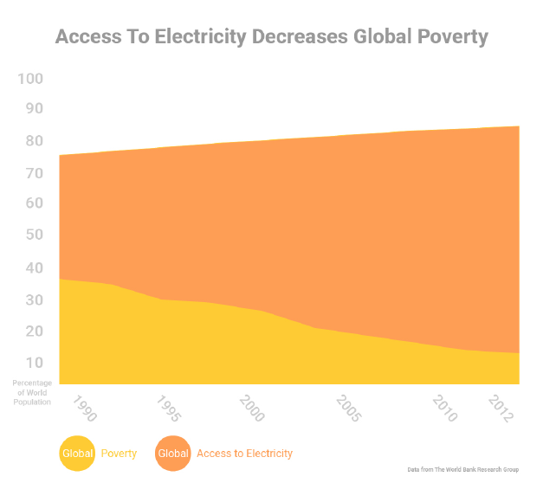
Using Graphs to Teach Sustainable Development

Slide 14
From the Ground Up: Energy Empowerment for Girls and Women
When women are empowered, they empower others
http://partnerstudio.huffingtonpost.com/caterpillar/light-the-way/
Teachers for Global Classroom Project

Slide 15
Girls & Women at the Center
The United Nations launched its Sustainable Energy for All (SE4A) initiative and declared 2014–2024 the Sustainable Energy for All Decade.

Slide 16
Advocacy Bumper Sticker or Graffiti Art
Have students develop a bumper sticker or piece of graffiti art that illustrates, informs, and advocates one of the sustainable development goals
Have students present their idea and product to the class
Option 2: Cubing Activity

Slide 17
Highlighted Resources & Curriculum Ideas
http://partnerstudio.huffingtonpost.com/caterpillar/light-the-way/
Page 8: Articles: Young people and SDGs; SDGs and Latin America; STEM Funding for SDGs
Page 8 – Role Play Activity
Page 9 – UNICEF and Model UN Lessons

Slide 18
Resources Highlighted
P. 9 A girl’s view of the 17 sustainable development goals— in pictures
P. 12 Analyzing data and indicators: Monitoring Gender Equality and the Empowerment of Women and Girls in the 2030 Agenda for Sustainable Development: Opportunities and Challenges (2015)
Lesson Plan: Understanding Gender & Statistics (Grades 11-12) STEM; Infusing Equity by Gender into the Classroom: A statistical analysis of data by gender

Slide 19
Student Reflection Question/Small Group Activity
If you could include an 18th SDG, what would it be and why?
What are some of the SDGs you think are most likely to be met? Which ones do you think might be more challenging and why?

Slide 20
Connecting the Local and the Global
Question: What can you do on an individual level to get involved in the struggle for women’s rights and gender equality? How can you make your community a better and more inclusive place?
P. 17 This article has a practical list of actions you can take to help accomplish the SDGs.
The following is a list of organizations that are dedicated to women’s rights and empowerment:
http://www.diversitybestpractices.com/news-articles/20-womens-organizations-you-need-know

Slide 21
The Bill & Melinda Gates Foundation
Challenge your students to think more about the SDGs by exploring the work being done at The Bill & Melinda Gates Foundation, based right here in Seattle. Take your class on a fieldtrip to the Foundation’s Visitor Center, or encourage students to visit on their own!

